Slide 1
Innovation For Measure Energy Consumption
Abstract:
This paper proposes a comprehensive approach to measure energy consumption through modular implementation. The aim is to accurately monitor and analyze energy usage in diverse settings, enabling informed decision-making for improved sustainability. The proposed system comprises three key modules: (1) Data Acquisition Module, which gathers energy consumption data from various sources; (2) Data Processing and Analysis Module, responsible for processing the acquired data and generating meaningful insights; and (3) Visualization Module, designed to present the analyzed data in an intuitive and informative manner. The integration of these modules provides a robust framework for monitoring and managing energy consumption, ultimately contributing to a more sustainable and energy-efficient future.
Module 1: Data Acquisition
The first module focuses on acquiring energy consumption data from various sources, including smart meters, sensors, and IoT devices. It collects real- time data and historical records to provide a holistic view of energy consumption.
Module 2: Data Preprocessing
To ensure accurate analysis, the data is preprocessed in module 2. This involves cleaning, filtering, and normalizing data, as well as handling missing values. Data preprocessing ensures the reliability of subsequent analysis.
Module 3: Data Analysis and Visualization
Module 3 is responsible for conducting in-depth analysis of energy consumption patterns. It employs statistical methods and machine learning algorithms to identify trends, anomalies, and opportunities for optimization. Visualizations, such as graphs and charts, aid in conveying the insights.

Slide 2
Module 4: Energy Efficiency Recommendations
This module provides actionable recommendations based on the analysis from module 3. It suggests strategies to reduce energy consumption, improve efficiency, and lower costs. These recommendations can range from equipment upgrades to behavioral changes.
Module 5: User Interface and Reporting
A user-friendly interface is crucial for stakeholders to interact with the system. Module 5 offers a dashboard that displays real-time energy consumption data and reports generated by module 3 and 4. It enables users to monitor progress and make informed decisions.
Module 6: Integration and Scalability
The system is designed to be modular and easily integrated into existing infrastructure. It can scale to accommodate diverse energy sources and accommodate the evolving needs of different industries.
Module 7: Security and Compliance
Ensuring the security of energy consumption data is paramount. Module 7 addresses data protection, access control, and compliance with relevant regulations to safeguard sensitive information.
In conclusion, the proposed modular system provides a comprehensive solution for measuring and managing energy consumption. Its adaptable design allows it to be deployed in various domains, including residential, commercial, and industrial settings, contributing to sustainability and cost savings.

Slide 3
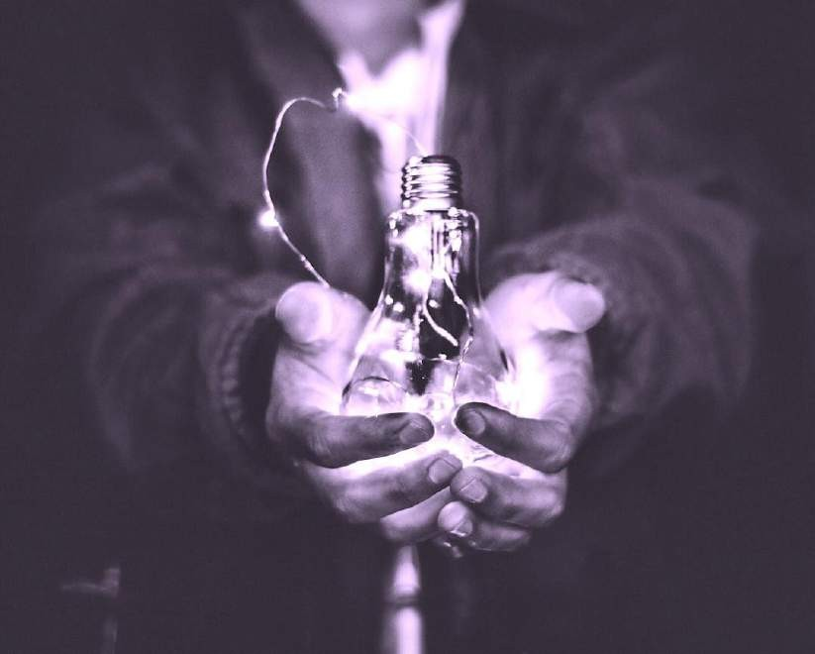
1.Introduction: Importance of measuring energy
consumption accurately.
In a wo r l d increasingly focused on conserving
energy, precise m e a s u r e m e n t of e n e rg y
c o n s u m p t i o n is vital. By i m p l e m e n t i n g
ef c i ent strategies to m e a s u r e and m o n i t o r e n e r g y usage, businesses can u n c o v e r
valuable insights and unleash the p o w e r of
precision. W i t h this n e w f o u n d understanding, organizations can o p t i m i z e e n e r g y usage,
r e d u c e costs, and m a k e i n f o r m e d decisions for a sustainable future.

Slide 4
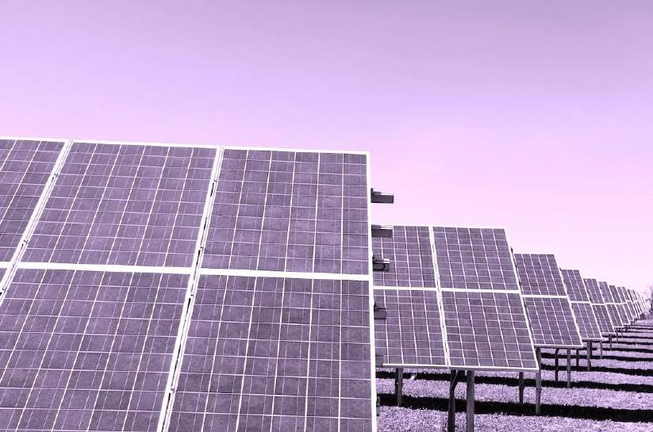
2. Understanding energy consumption metrics
and their significance.
To effectively m e a s u r e e n e r g y c o n s u m p t i o n ,
i t is crucial to u n d e rs t a n d key metrics a n d
their signi cance. Metrics such as
k i lowatt- hours ( k Wh), p e a k d e m a n d , a n d
p o w e r factor can provide insights into e n e r g y usage patterns, ef ciency levels, and potential
areas for i m p r o v e m e n t . By analyzing these metrics, businesses can identify opportunities for e n e r g y optimization, cost reduction, a n d sustainable practices.

Slide 5
W h i l e m e a s u r i n g e n e r g y c o n s u m p t i o n , there
are several challenges that need to b e
addressed. These i nclude data accuracy, access to real- t ime information, and data integration f r o m different sources.
Additionally, e n s u r i n g data security a n d privacy is essential to m a i n t a i n t rust a n d
compliance. By o v e r c o m i n g these challenges,
businesses can u n l o c k the p o w e r of precision
in e n e r g y m e a s u r e m e n t and m a k e i n f o r m e d decisions for e n e r g y ef ciency a n d
sustainability.
3. Key challenges in measuring energy
consumption e‰ciently.

Slide 6
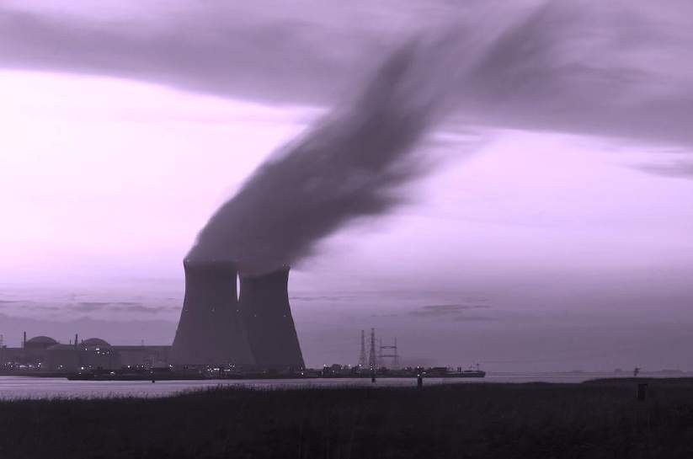
A d v a n c ed m e t e r i n g technologies offer
accurate and real- t ime m e a s u r e m e n t s of
e n e r g y c o n s u m p t i o n , e n a b l i n g businesses to identify inef ciencies and o p t i m i z e e n e r g y
usage. These technologies i nclude s m a r t meters, s u b m e t e r i n g systems, and e n e r g y
m a n a g e m e n t software. By leveraging these tools, businesses can gain valuable insights into their e n e r g y c o n s u m p t i o n patterns and
i m p l e m e n t targeted strategies for i m p r o v e d e n e r g y ef ciency and sustainability.
4. Section 1:Leveraging advanced metering
technologies for precise measurements.

Slide 7
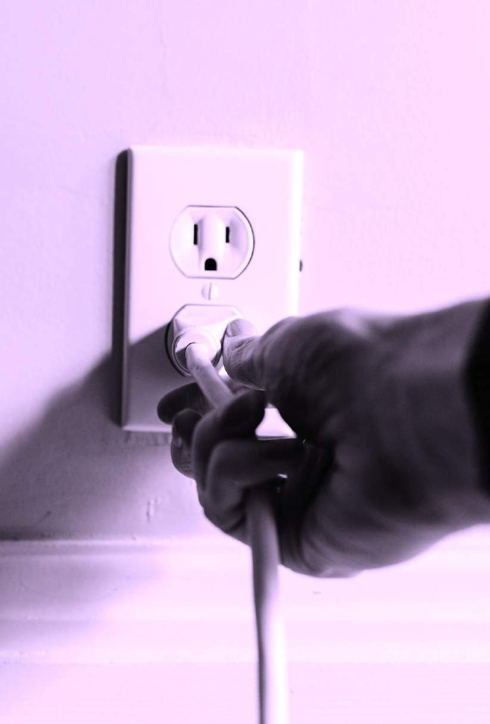
The Internet of Things (IoT) plays a crucial role
in o p t i m i z i n g e n e rg y c o n s u m p t i o n
monitoring. W i t h IoT- enabled devices,
businesses can g a t h e r granular data on
e n e r g y c o n s u m p t i o n in real- t ime. This data can then be analyzed to identify
energy- saving opportunities, set benchmarks, and t rack progress towards sustainability
goals. IoT also allows for r e m o t e m o n i t o r i n g
and control, e n a b l i n g businesses to m a k e
t i m e l y a d j u s t m e n t s and o p t i m i z e e n e r g y usage ef ciently.
5. Therole of IoTin optimizing energy
consumption monitoring.

Slide 8

To fully leverage the p o w e r of precision in
e n e rg y c o n s u m p t i o n , data analytics is
essential. By collecting and analyzing
granular data f r o m IoT- enabled devices,
businesses can gain detailed insights into their e n e r g y c o n s u m p t i o n patterns. This
i n f o r m a t i o n can identify areas of
i m p r o v e m e n t , o p t i m i z e e n e r g y usage, a n d
m o n i t o r progress towards sustainability goals
effectively. W i t h data- driven decision- making,
businesses can achieve greater ef ciency a n d cost savings in their e n e r g y m a n a g e m e n t
strategies.
6. Section 2: Implementing data analytics for
detailed energy consumption insights.

Slide 9
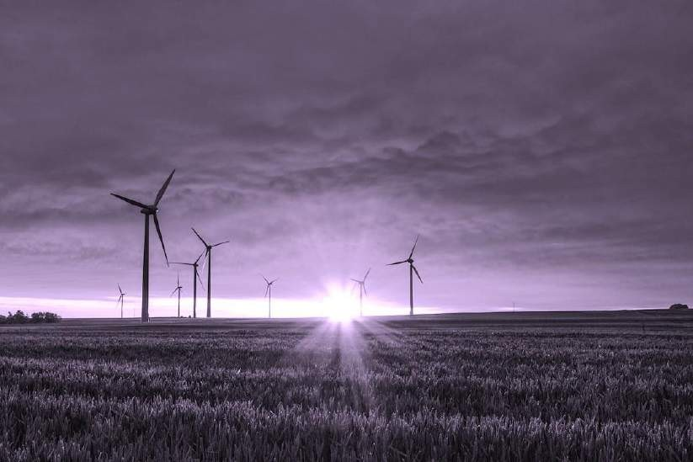
7. Casestudies showcasing successful energy
measurement strategies.
To u n d e r s t a n d the practical application of
e n e rg y m e a s u r e m e n t strategies, let's explore a f e w case studies. These real-life examples will h i g h l i g h t successful i m p l e m e n t a t i o n s of precision e n e r g y c o n s u m p t i o n m e a s u r e m e n t techniques. We will delve into the challenges faced, the solutions i m p l e m e n t e d , and t h e
positive o u t c o m e s achieved. These case
studies will provide valuable insights a n d
inspire businesses to adopt ef c i ent strategies for m e a s u r i n g e n e r g y
c o n s u m p t i o n .

Slide 10
8. Section 3: Integrating energy monitoring tools
with smart building systems.
Integrating e n e r g y m o n i t o r i n g tools w i t h s m a r t b u i l d i n g systems can revolutionize e n e r g y ef ciency practices. By leveraging real- t ime data, businesses can o p t i m i z e
e n e r g y c o n s u m p t i o n , identify areas of
i m p r o v e m e n t , and i m p l e m e n t a u t o m a t e d
controls to m a x i m i z e e n e r g y savings. This seamless integration ensures a
c o m p re h e n s i ve approach to e n e rg y
m a n a g e m e n t , e m p o w e r i n g businesses to r e d u c e costs, m i n i m i z e e n v i r o n m e n t a l
impact, and e n h a n c e overall operational ef ciency.

Slide 11

To unleash the p o w e r of precision in m e a s u r i n g energy consumpt i on , businesses should consider i m p l e m e n t i n g these strategies:
Conduct regular energy audits to identify areas of inef ciency.
Utilize smart meters and m o n i t o r i n g systems for real- time data collection.
Set measurable energy consumption goals and t rack progress.
Implemen t a u t o m a t e d controls for ef cient energy
usage.
Educate employees on energy- saving practices.
Optimize lighting and HVAC systems for m a x i m u m
ef ciency.
Consider renewa bl e energy sources and energy storage solutions.
Continuously analyze and interpr et energy data t o identify further optimizat io n opportunities.
Periodically review and update energy m a n a g e m e n t
strategies to adapt to n e w technologies a n d advancements.
9. Best practices for optimizing energy
consumption through precise measurement.

Slide 12

10.Conclusion: Harnessing the potential of precise
energy consumption measurement.
Ef ciently m e a s u r i n g e n e r g y c o n s u m p t i o n is
crucial for businesses seeking to o p t i m i z e
their operations and r e d u c e costs. By
i m p l e m e n t i n g strategies such as regular
e n e r g y audits, utilizing s m a r t meters, setting goals, and e d u c a t i n g employees, businesses
can u n l o c k the p o w e r of precision in e n e r g y m e a s u r e m e n t . Continuously analyzing a n d
a d a p t i n g e n e rg y m a n a g e m e n t strategies will
lead to further optimization and harness t h e
full potential of precise e n e r g y c o n s u m p t i o n m e a s u r e m e n t .

Slide 13
1.Introduction: Importance of measuring energy
consumption accurately.
In a wo r l d increasingly focused on conserving
energy, precise m e a s u r e m e n t of e n e rg y
c o n s u m p t i o n is vital. By i m p l e m e n t i n g
ef c i ent strategies to m e a s u r e and m o n i t o r e n e r g y usage, businesses can u n c o v e r
valuable insights and unleash the p o w e r of
precision. W i t h this n e w f o u n d understanding, organizations can o p t i m i z e e n e r g y usage,
r e d u c e costs, and m a k e i n f o r m e d decisions for a sustainable future.

Slide 14
import time
# Simulated energy monitoring device
class EnergyMonitor:
def init (self):
self.total_energy_consumed = 0 # Total energy consumed (in watt-hours) self.start_time = time.time() # Start time for measurement
def record_energy(self, energy):
current_time = time.time()
elapsed_time = current_time - self.start_time
# Calculate energy consumption in watt-hours
energy_consumed = energy * elapsed_time / 3600 # Assuming energy is in watts
# Update total energy consumption
self.total_energy_consumed += energy_consumed
# Update start time for the next measurement
self.start_time = current_time
def get_total_energy_consumed(self):
return self.total_energy_consumed
# Example usage

Slide 15
if name == " main ":
energy_monitor = EnergyMonitor()
# Simulated energy measurements (in watts) over time
energy_measurements = [100, 150, 120, 200, 180]
for energy_measurement in energy_measurements:
energy_monitor.record_energy(energy_measurement)
print(f"Current total energy consumption: {energy_monitor.get_total_energy_consumed()} watt- hours")
print(f"Final total energy consumption: {energy_monitor.get_total_energy_consumed()} watt-hours")

